Slide 1

9
Closing the Project

Slide 2
Chapter Concepts
Actions that should be taken when closing a project
Conducting a post-project evaluation
The importance of documenting lessons learned
The need to organize and archive project documents
Obtaining feedback from the customer about the project
Early termination of projects

Slide 3
Learning Outcomes
Identify actions that should be taken during the process of closing a project
Conduct a post-project evaluation
Discuss the value and use of lessons learned
Explain the importance of organizing and archiving project documents
Obtain customer feedback about the project
Describe situations that could result in early project termination

Slide 4
Project Integration Management
Project Procurement Management
Project Management Knowledge Areas from PMBOK® Guide

Slide 5
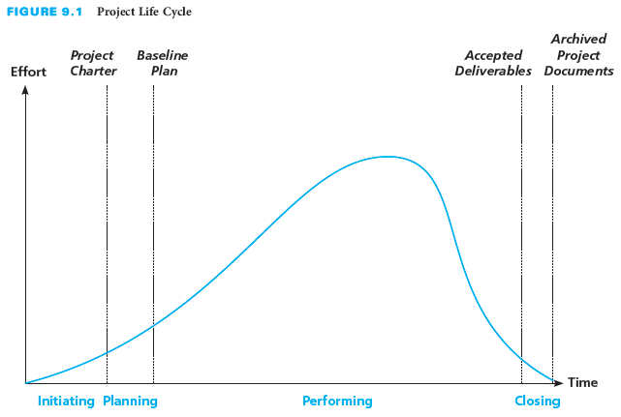
Project Closing Actions
Collect and make final payments
Recognize and evaluate staff
Conduct post-project evaluation
Document lessons learned
Organize and archive project documents

Slide 6
Final Payments
Payments from customer
  Have activity listed to perform collection
  Assure that all the payments have been received
Payments to others
  Verify all payments have been made
  Record actual costs
Account closing
  Perform financial analysis on the project
  Compare actual costs versus baseline budget

Slide 7
Staff Recognition And Evaluation
End project with recognition and celebration
  Recognize team members for contributions
  Celebrate the success of the project
Prepare individual performance evaluations
  Mention how knowledge expanded during project
  Identify areas where need further development
  Share during individual meetings or give to supervisor

Slide 8
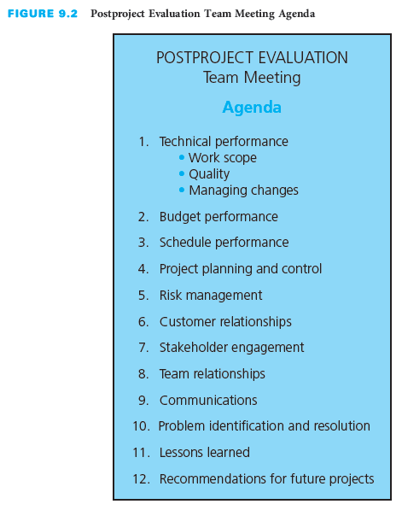
Post Project Evaluation
Review and evaluate project performance
Identify improvements
Hold individual meetings with members
Hold project team meeting
Prepare written report with lessons learned and recommendations

Slide 9
Lessons Learned
Purpose of identifying and documenting
  Capitalize on knowledge and experience gained
  Improve performance on future projects
Knowledge base system or repository
  Retrieve lessons learned from prior projects
  Easily access information by category or subject
Record keeping throughout project
  Capture lesson at time of lesson instead of end of project
  Have as agenda topic at meetings and in training sessions

Slide 10
Archive Project Documents
Organize, file, and archive appropriate documents
Organize system to make information easily retrievable
Create database of common data elements
  Analyze elements for trends
  Examine records for bidding, planning, and performing future projects

Slide 11
Customer Feedback
Post-project evaluation meeting with customer
  Determine if provided the expected benefits
  Assess the level of customer satisfaction
  Obtain any feedback with open-ended questions
  Discuss future opportunities
  Secure permission to use as reference
Participants
  Key project team members
  Key customer representatives
  Project manager

Slide 12
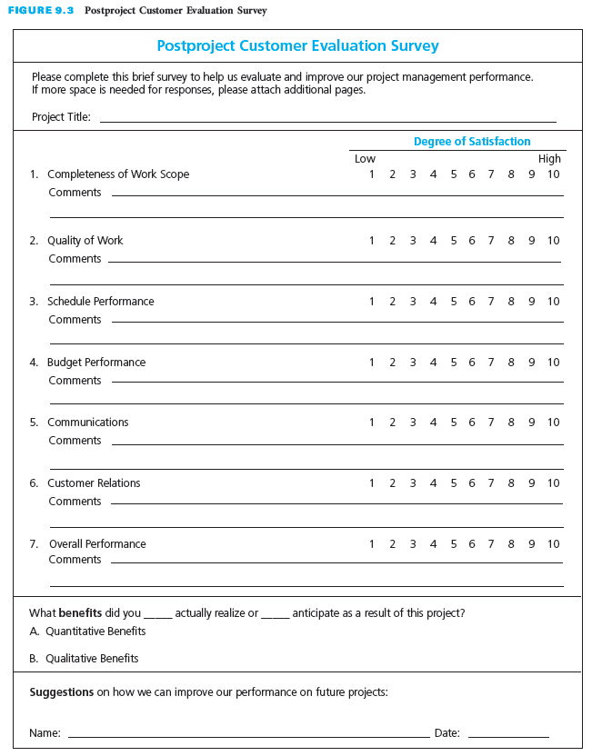
Post-Project Customer Evaluation Survey
Analyze for trends
Seek permission for reference

Slide 13
Critical Success Factors
Recognize the project team and celebrate accomplishments throughout the project.
Regularly ask the customer about the level of satisfaction with the performance and progress of the project and take corrective action at the first hint that the customer is not satisfied.
After the conclusion of a project, the project performance should be evaluated to learn what could be improved if a similar project were to be done in the future. Feedback should be obtained from the customer and the project team.
Capture and document lessons learned throughout the performance of the project.
Establish a knowledge base of lessons learned and ensure that they are communicated and used on future projects.
Organize and archive project documentation and analyze key data that could be helpful in bidding, planning, or performing future projects.
Retain customer evaluation and feedback information that could be valuable in developing proposals for other projects for the same customer in the future.

Slide 14
Summary
The fourth and final phase of the project life cycle is closing the project.
An important project closing action is staff recognition and evaluation.
Conduct post-project evaluation meetings within the project team or organization with individual team members and a group meeting with the project team to gather team feedback for improved future performance.
Identify and document lessons learned to capitalize on the knowledge and experience gained on the project in order to improve performance on future projects.
The project team or contractor should ensure that copies of appropriate project documentation are properly organized, filed, and archived so that they can be readily retrieved for future use.
Conduct a post-project evaluation meeting, or distribute a customer evaluation survey to the customer or sponsor to determine whether the project provided the customer with expected benefits; assess the level of customer satisfaction; and obtain any feedback that would be helpful in future business relationships with this customer or with other customers.
Projects may be terminated before completion for various reasons.

